Slide 1

Home Automation
Module
Anant Kaushik

Slide 2
Contents
Title | Page
Introduction | 3
Hardware Required | 4
Description | 5
Relay | 6
Technical Parameters of Relay | 7
Circuit Diagram | 8
Software Installation in Omega | 9
Setup Losant | 10
Software Installation in Server | 23
Running the system | 24

Slide 3
Home Automation
Home automation is a wireless home appliance control system accessed by a remote device such as mobile phone or any web browser to allow a home owner to control, monitor and coordinate home appliances like lights, fans, or any other thing without changing any home infrastructure.
We are also storing the data like time when the appliance is turned on or off, in the database so that further analysis can be done if required specially in the case of industrial appliances.

Slide 4
Hardware requirements
Onion Omega 2+
Expansion Dock
Relay
Wires
Led Bulb
Power Supply

Slide 5
Description
Home automation gives you access to control devices in your home from a mobile device anywhere in the world.
Here we are going to implement Home Automation in which we can switch On/Off the Led Bulb from anywhere around the world. We can also set timer to switch On/Off the bulb.
The microcontroller i.e. the omega 2+ receives commands/instructions from the cloud and then controls the appliance as per the instruction(on or off).

Slide 6
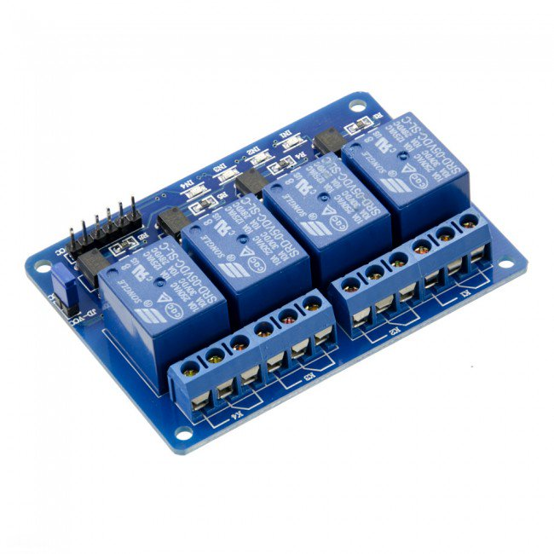
Relay
This is a 5V 4-channel relay interface board, and each channel needs a 15-20mA driver current. It can be used to control various appliances and equipment with large current. It is equipped with high-current relays that work under AC250V 10A or DC30V 10A. It has a standard interface that can be controlled directly by microcontroller.

Slide 7
Technical Details
Electrical Parameters | 5V 4 channel relay
Trigger Voltage | 5V DC
Trigger Current (Nominal current) | 70mA
Maximum AC load current | 10A @ 250/125V AC
Maximum DC load current | 10A @ 30/28V DC
Operating time | 10msec
Release time | 5msec
Maximum switching | 300 operating/minute
Notes:
https://www.itead.cc/wiki/DHT11_Humidity_Temperature_Sensor_Brick

Slide 8
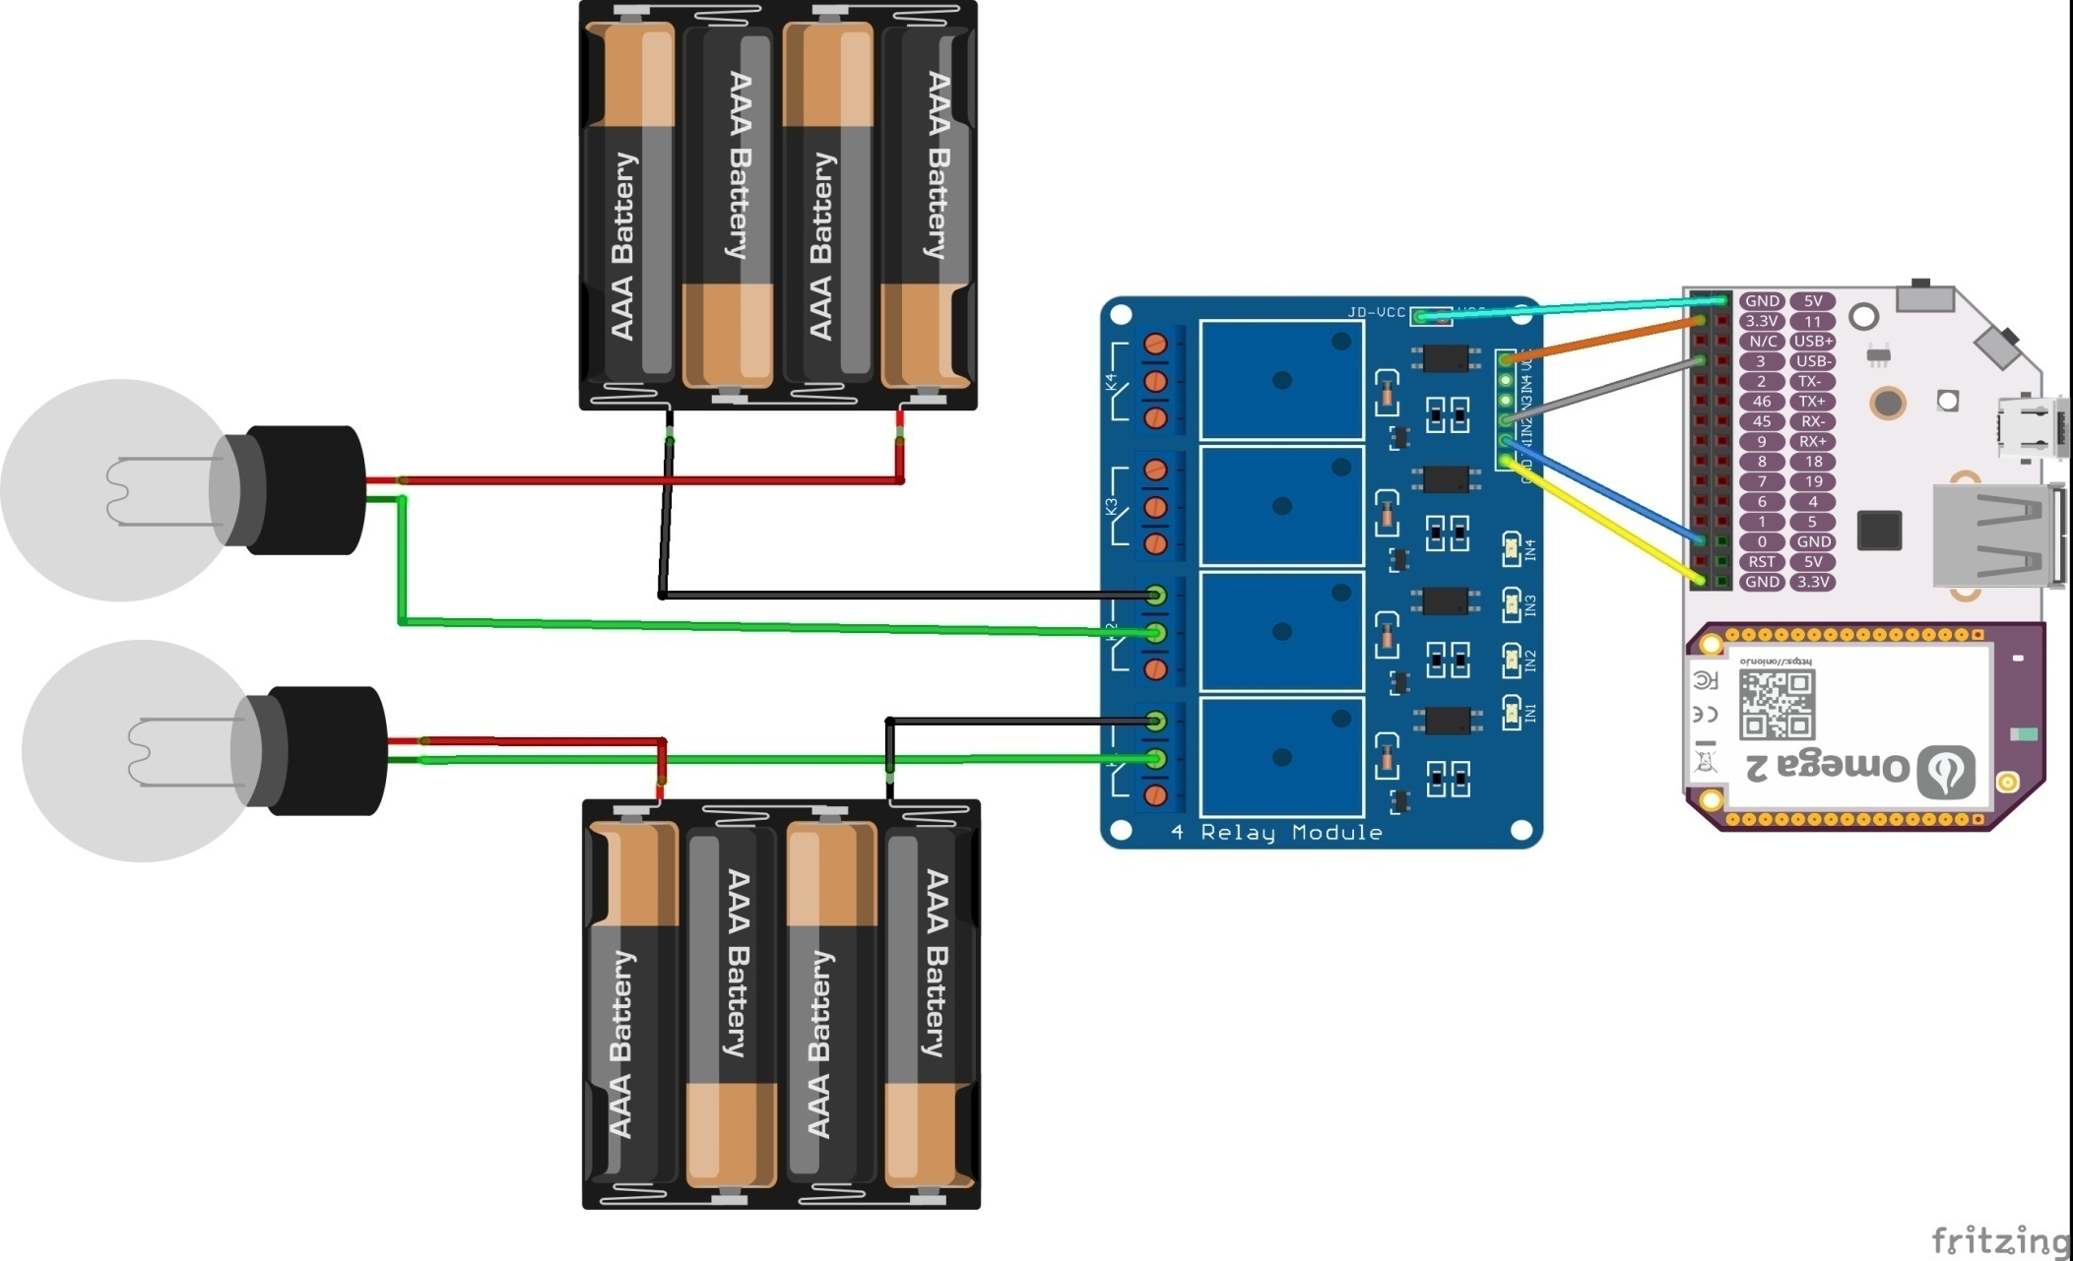
Circuit Diagram

Slide 9
Software installations in Omega
Follow this link for first time setup of Omega - https://docs.onion.io/omega2-docs/first-time-setup.html
Once you are ready, type the following commands :-
opkg update
opkg install python pyOnionGpio
opkg install python-pip
pip install paho-mqtt
git clone https://github.com/Losant/losant-mqtt-python.git
Download the sender.py file from https://github.com/anantkaushik/IoT-MQTT.git

Slide 10
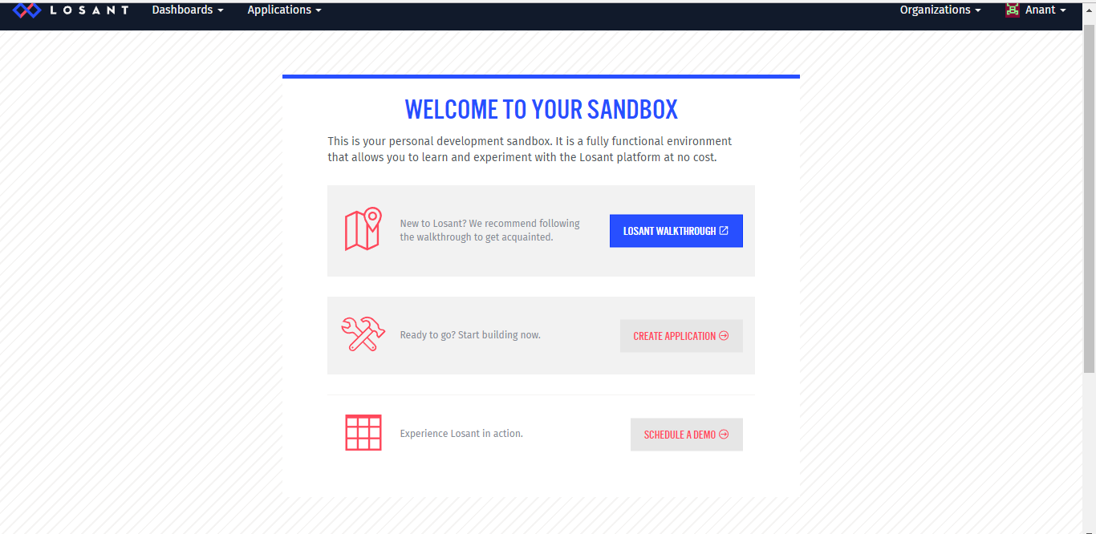
Set Up Losant
Create your account on losant.
Create an application on Losant. When you Logged in You’ll get the screen like
Click on “CREATE APLLICATION”

Slide 11
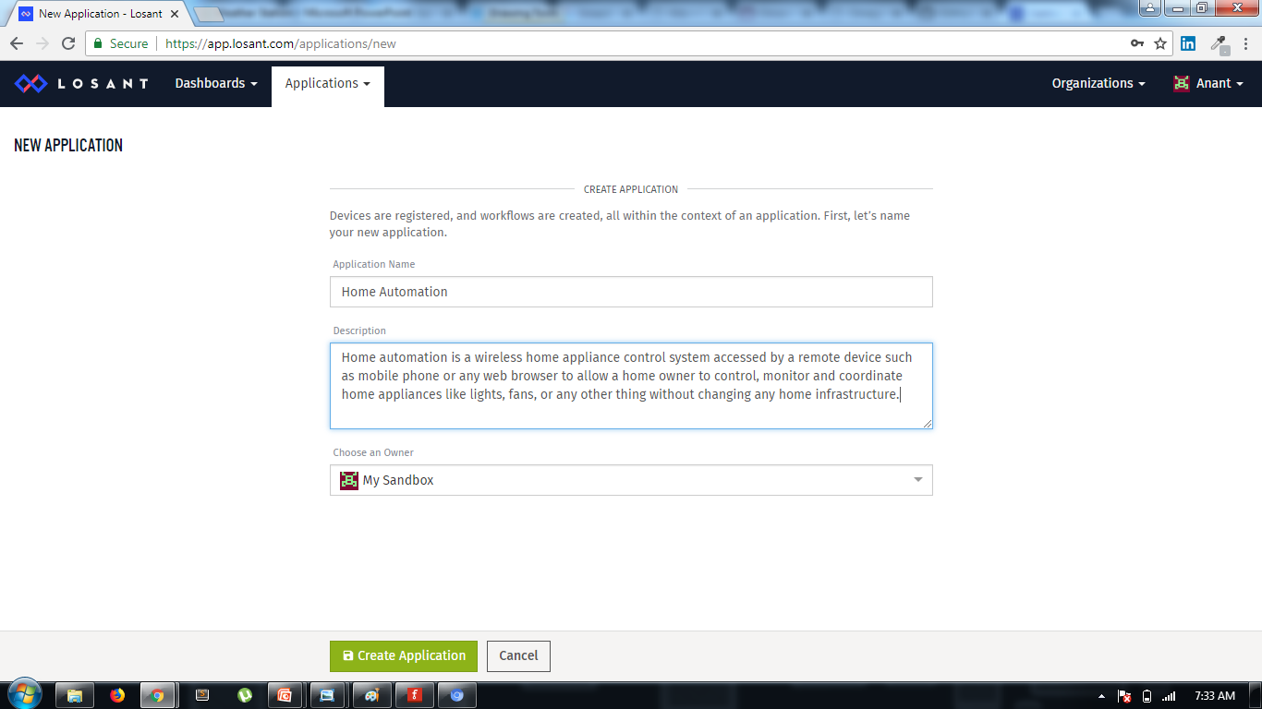
Set Up Losant
Enter the name of your Application say Home Automation.
Write the description of the Application.
Click on Create application.

Slide 12
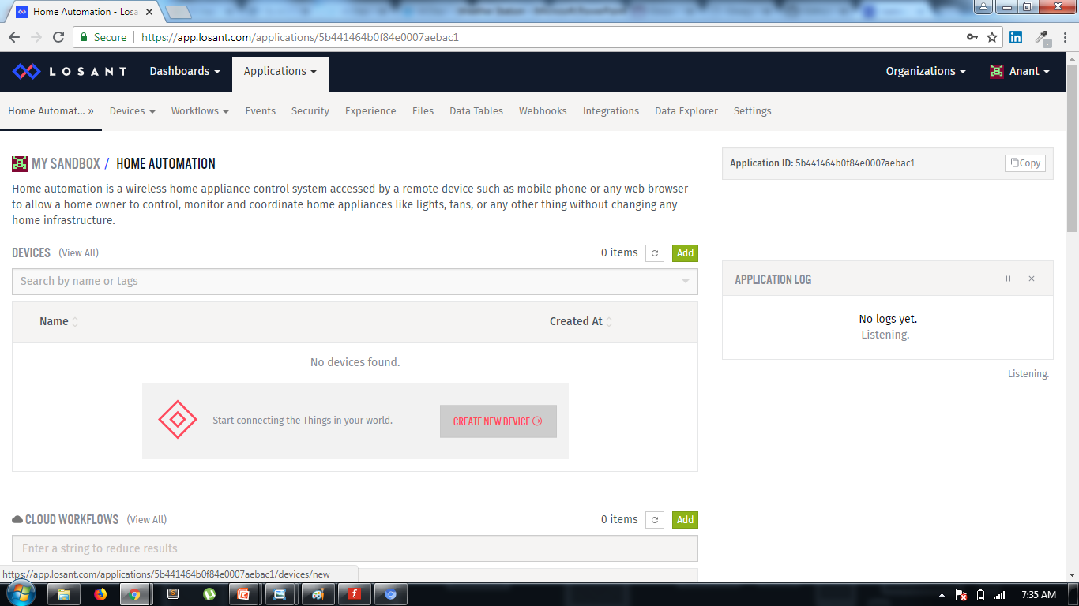
Set Up Losant
Add Device to your Application by clicking on “CREATE NEW DEVICE”.

Slide 13
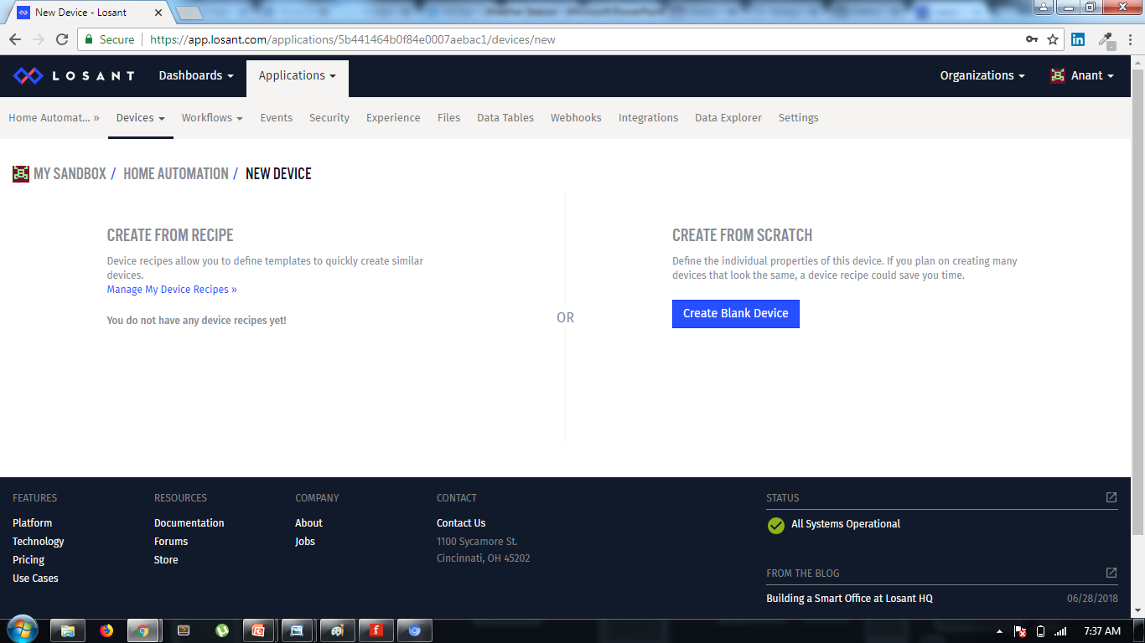
Set Up Losant
Create your Device from Scratch by clicking on “CREATE BLANK DEVICE”.

Slide 14
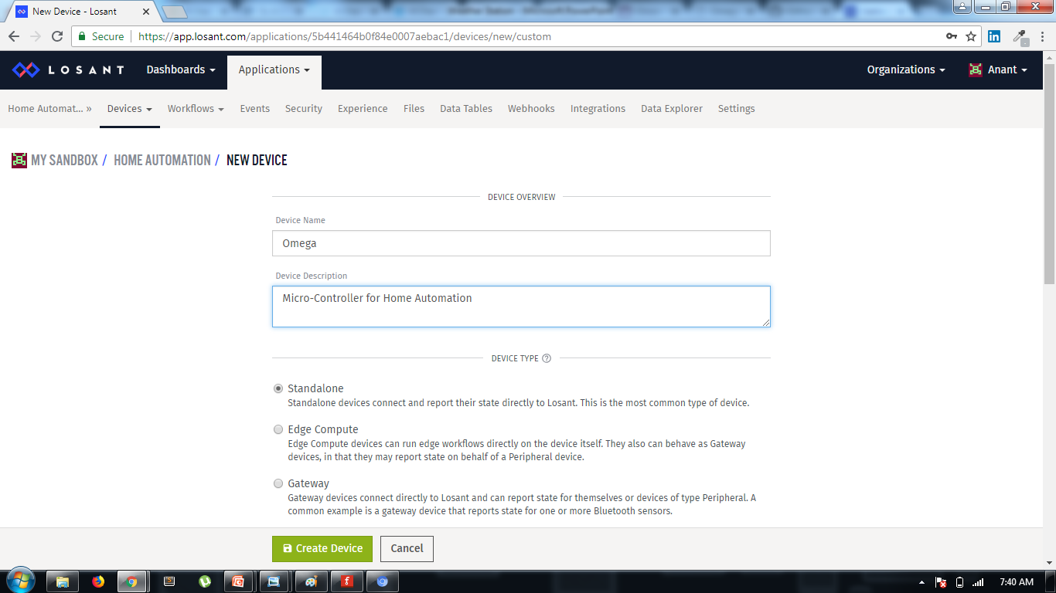
Set Up Losant
Enter the name of your Device.
Enter the Description of your Device.
Any other information is not Compulsory. So Click on “CREATE DEVICE”

Slide 15
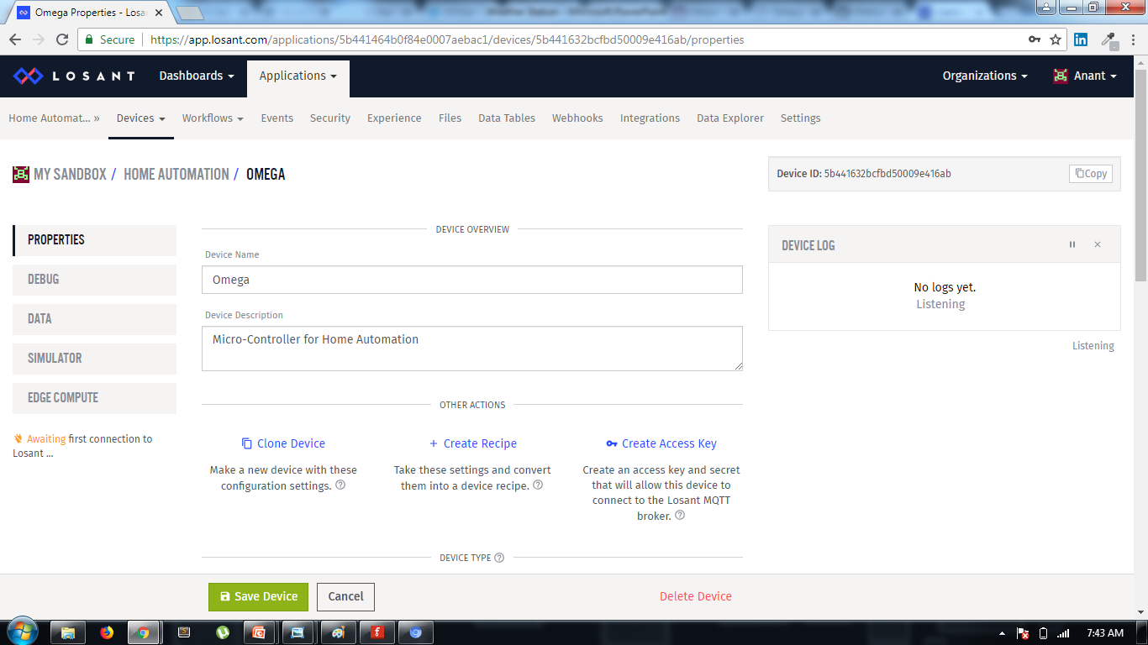
Set Up Losant
Save your Device by clicking on “SAVE DEVICE”.

Slide 16
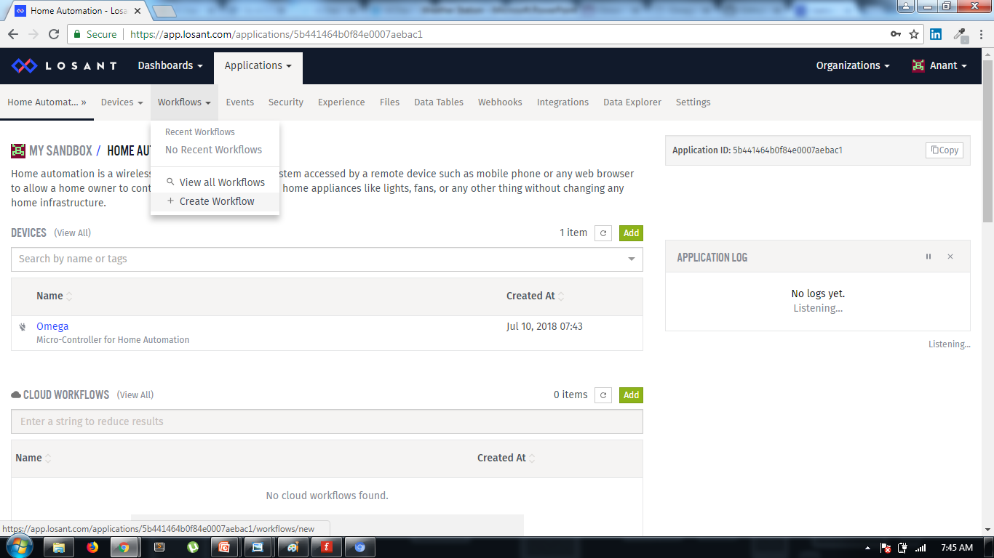
Set Up Losant
Add workflow to your application to send and receive the command from the device.
Click on Workflows in the Navbar.
Click on “Create Workflow” to add workflow to your application.

Slide 17
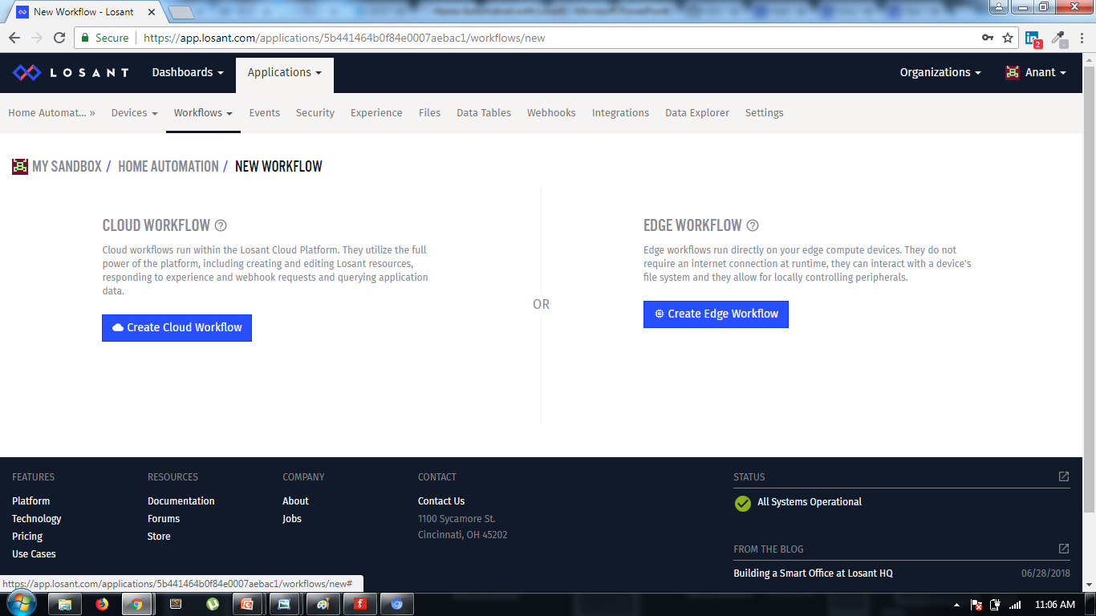
Set Up Losant
Click on “Create Cloud WorkFlow”.

Slide 18
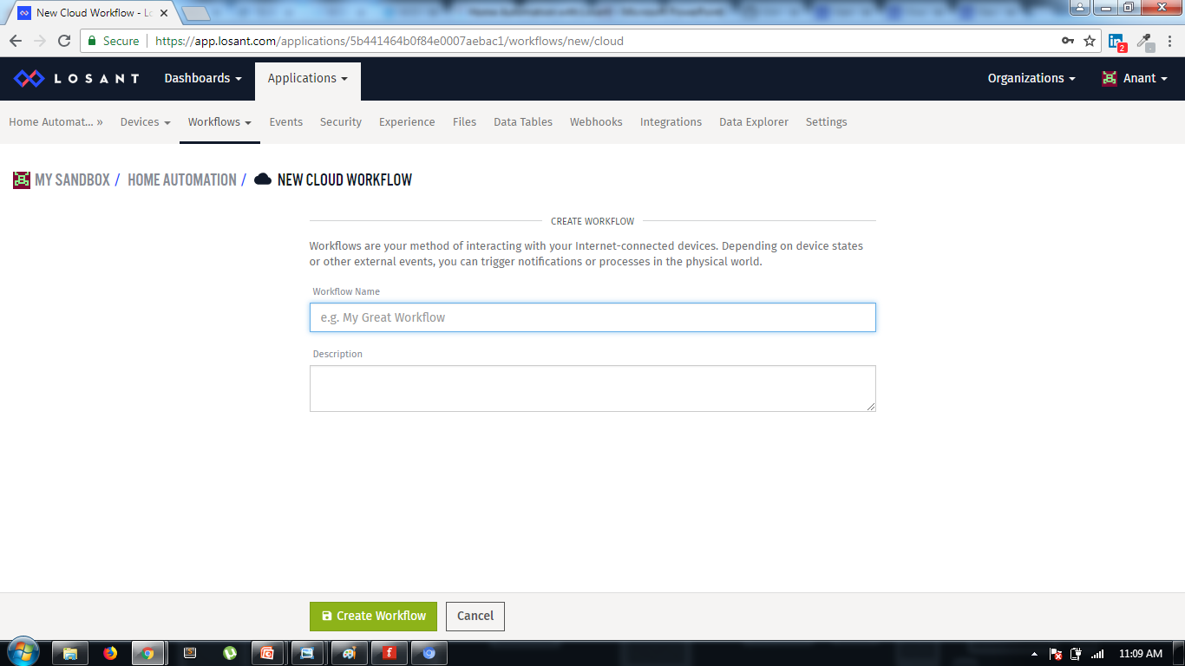
Set Up Losant
Enter the name of the Workflow.
Enter the description of the Workflow.

Slide 19
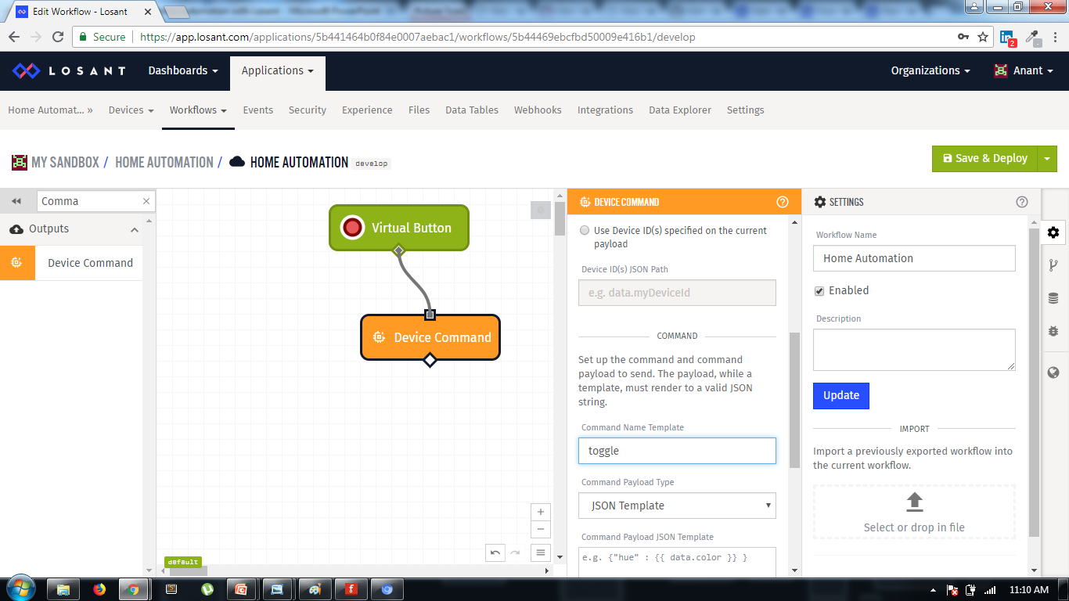
Set Up Losant
Drag and Drop Virtual Button and Device Command to the Workflow.
Connect Virtual Button and Device Command.
Set the name of device command to “togglelight”.

Slide 20
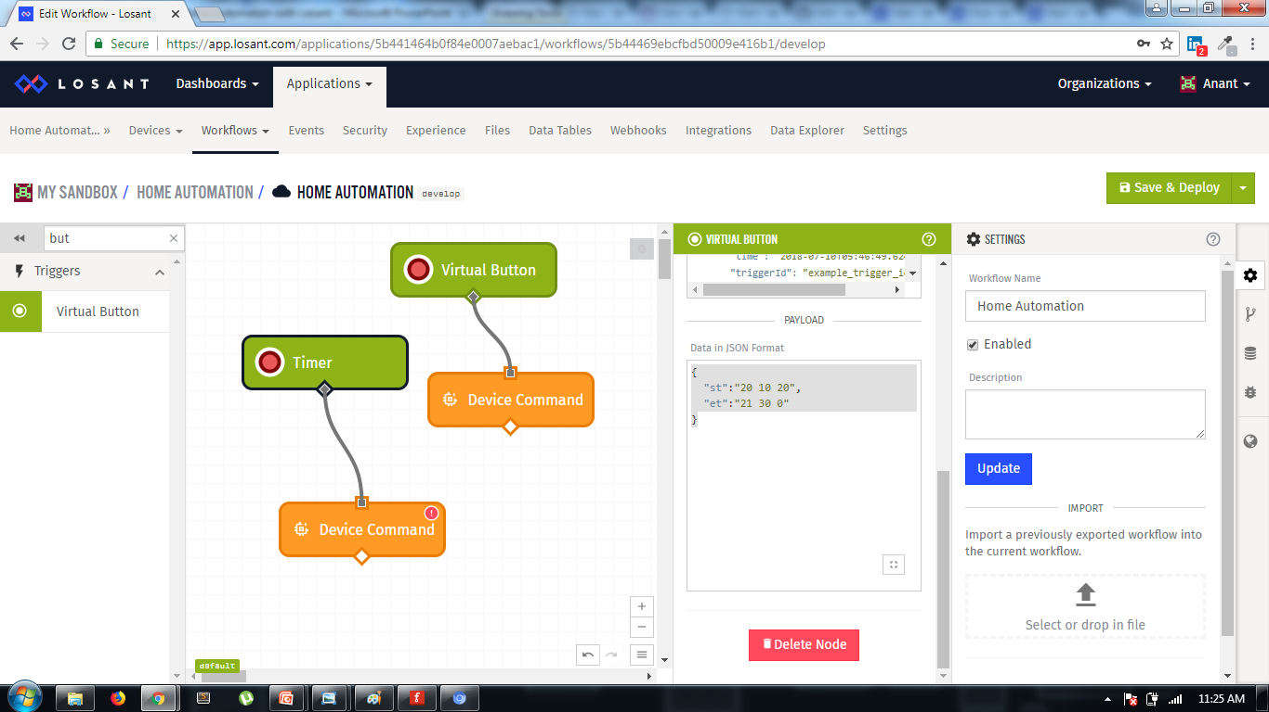
Set Up Losant
Drag and Drop another Virtual Button and Device Command to the Workflow.
Connect Virtual Button and Device Command.
Set the name of device command to “toggle” and set the name of Virtual Button to Timer. Give your payload data to the “Timer” device command to send data to the device.

Slide 21
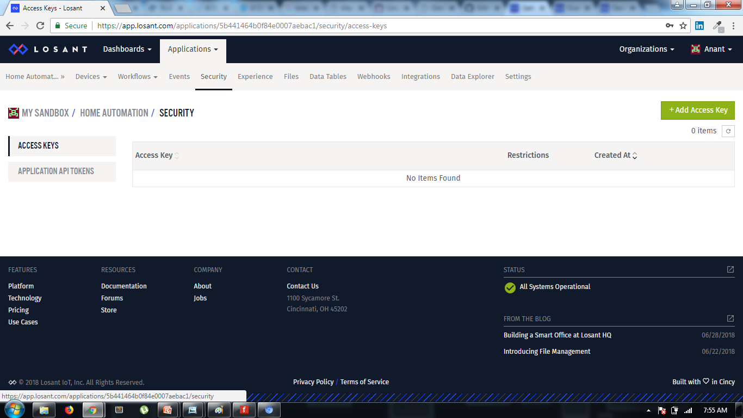
Set Up Losant
Generate Access Key for you application.
Click on “Security” in Navbar.
Click on “Add Access Key”.

Slide 22
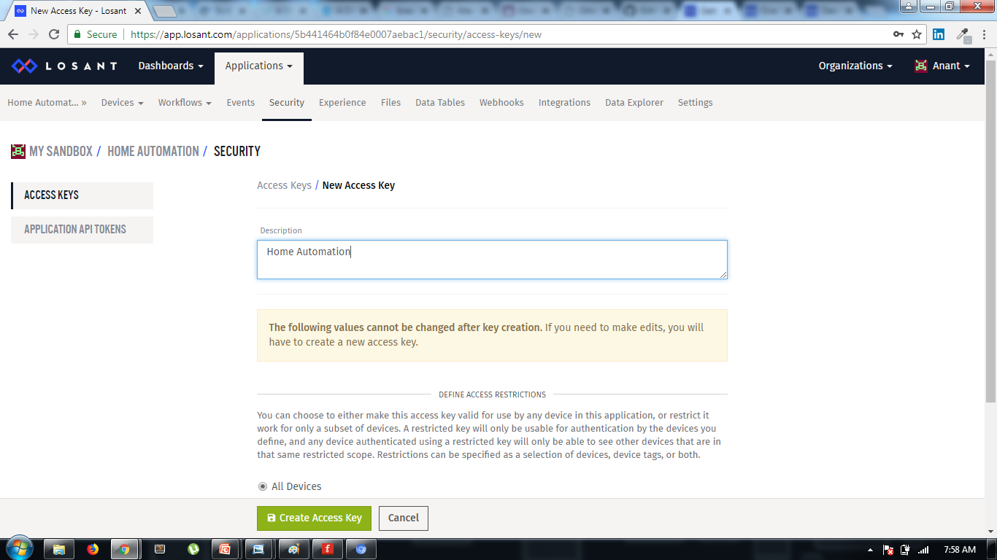
Set Up Losant
Enter Description, then Click on “Create Access Key”. You’ll get an screen from which you can copy/download you access key.
Replace the “XXXXX” with your access key in the code.

Slide 23
Software installations in Server/Your system
**Currently, we are creating our system as a Server. We can also host this server file over cloud service providers like AWS (that supports python and web socket).**
Install Python3 on your system - https://www.python.org/downloads/ (Make sure you have set environment variable for python.)
Create a folder ‘home-automation’ and access it using CMD.
Run command –
pip install flask flask-mqtt flask-socketio eventlet
Clone the required files from github - https://github.com/anantkaushik/IoT-MQTT.git
Open the cloned folder, copy all its files to your ‘home-automation’ folder. You can access the database file using ‘sqlite browser’.

Slide 24

Running Complete system
Once you are ready with the Losant setup and workflow and you have your program in the omega 2+, then run the file in omega.
Wait for a couple of seconds and you can see the “Device connected” message on Losant in listener panel.
Once the omega program and Losant are successfully connected, You can sent command from the losant workflow. Losant can automatically handle the sending of commands and receiving them over omega when they are connected to each other.
Use “Toggle button” to switch on or off.
Give parameters in device button payload of Timer button in
{
"st":“hr mm ss",
"et":“hr mm ss"
}
format to turn on and off with a timer.

Slide 25
Thank You !
Contact US
Nitin Sinha
nitin.sinha@goSigmaWay.com
+1 727-394-4375
+91 7838188809
Debjani Mitra
debjani.mitra@goSigmaWay.com
+1 952-583-3449
+91 9339555636
Anant Kaushik
anant.kaushik2@gmail.com
+91 8791262398

